Slide 1
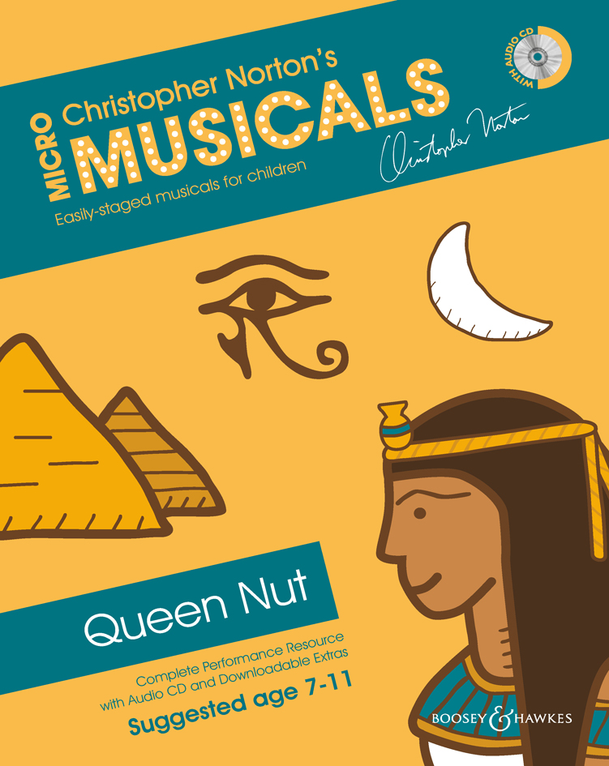
QUEEN NUT
Script & Songs

Slide 2
SONG 1
THE EGYPTIANS
© Copyright 2014 by Boosey & Hawkes Music Publishers Ltd

Slide 3
Pyramids.
Astronomy.
Hieroglyphics.
Boat construction.
Dam construction.
Make-up.
Jewellery.
Egyptians made all of these.
(And don’t forget mummification!)

Slide 5
NARRATOR 1:
Nut was the goddess of the sky
and protector of the earth.

Slide 6
NARRATOR 2:
Ra, the sun god,
was the most important of the gods.
He decided to become a man for a time
in order to rule as Pharaoh.

Slide 7
NARRATOR 1:
And Thoth was the god of wisdom
and magic.
He was the Royal Seer
who divines the future.

Slide 8
NARRATOR 2:
One day Thoth was talking to Ra:

Slide 9
RA:
Thoth, tell me my future!
As Pharaoh, I order you to tell me my future!

Slide 10
THOTH:
Are you sure you wish to know?
The future is what it is.
You have to accept whatever it brings –
it cannot be changed.

Slide 11
RA:
I understand that, but I am curious.

Slide 12
THOTH:
Very well then.
I see that there will be another ruler
of Egypt after you –
and he will be the son of Queen Nut!

Slide 13
RA:
Queen Nut?
That cannot be.
I will curse her so that she cannot have
children who might threaten my authority.

Slide 15
NARRATOR 1:
Meanwhile, Queen Nut is on her throne,
surrounded by wise men,
servants and courtiers.
But something is worrying her:

Slide 16
NUT:
I have everything anyone
could possibly want.
I have the finest clothes
and the most splendid jewellery.

Slide 17
ADVISOR:
You are indeed most fortunate, Your Majesty.

Slide 18
NUT:
I have a beautiful palace,
and the richest, most delicious food
to enjoy...

Slide 19
ADVISOR:
...and shoes – you have fabulous shoes,
Your Majesty.

Slide 20
NUT:
Quite. But despite all of these things,
there’s still something missing.

Slide 21
ADVISOR:
Not this again, Your Majesty.
You know there’s no way that Ra will allow it!

Slide 22
NUT:
I don’t care. I want to have children,
and Ra is not going to stop me!

Slide 23
ADVISOR:
I don’t think that’s a very good idea,
Your Majesty.
There will be serious consequences,
I’m certain!

Slide 24
NARRATOR 1:
When Ra heard that Nut had decided
to have a child, he became very angry.

Slide 25
SONG 2
RA – THE SUN GOD
© Copyright 2014 by Boosey & Hawkes Music Publishers Ltd

Slide 26
Ra – the sun god, ruler alone,
feared that someone
would take his throne.
A year of three hundred and sixty days.
Ra gives an order, but Nut disobeys.
Nut was in trouble, Nut was in strife:
she wanted children, but wasn’t Ra’s wife!

Slide 27
Ra – the sun god, ruler alone,
feared that someone
would take his throne.
Nut disobeyed him; she heard him declare,
‘you shan’t give birth any day of the year.’
Nut was in trouble, Nut was in strife:
she wanted children, but wasn’t Ra’s wife!

Slide 29
SERVANT 1:
Have you heard the latest news at the court?
Nut has announced that she’s
going to have children
and that she will be the mother
of the next Pharaoh!

Slide 30
SERVANT 2:
Uh-oh. I see trouble ahead.
Ra has made it very clear that any decisions
about the next Pharaoh are his decisions.
Nut had better be very careful.

Slide 31
SERVANT 3:
Too late for that.
Her announcement is all over town.
Ra is going to be really angry...

Slide 32
SERVANT 1:
...and you know what he’s like
when he’s angry...

Slide 33
SERVANT 2:
Incandescent?

Slide 34
SERVANT 3:
Well, he is the sun god…

Slide 36
SONG 3
HAVE YOU HEARD?
© Copyright 2014 by Boosey & Hawkes Music Publishers Ltd

Slide 37
Have you heard?
Can it be true?
Queen Nut said
she will give birth
to the future Pharaoh,
to the future Pharaoh.

Slide 38
Have you heard?
Can it be true?
Queen Nut said
she will give birth
to the future Pharaoh,
to the future Pharaoh.

Slide 40
RA:
I thought my word on the matter
of the next Pharaoh was quite clear.
The news about Queen Nut is very serious.
So serious, in fact,
that I feel a curse coming on…

Slide 42
SONG 4
I CURSE YOU!
© Copyright 2014 by Boosey & Hawkes Music Publishers Ltd

Slide 43
RA:
I curse you!
I curse the child you say you bear!
I hate you!
I hate the way you will not hear
that I’m the sun god,
I’m your ruler!’

Slide 44
I curse you!
I curse the child you say you bear!
I hate you!
I hate the way you will not hear
that I’m the sun god,
I’m your ruler!’

Slide 45
ALL:
Nut shall not give birth
any day of the year
or she’ll be cursed!

Slide 47
NARRATOR 1:
Thoth was regarded as the god to go to
for settling disputes.
So Nut, who had heard about Ra’s reaction,
went straight to Thoth
to see if he could help her.

Slide 48
NARRATOR 2:
Thoth wanted to marry Nut anyway,
so he was happy to be
as helpful to her as possible…

Slide 50
SONG 5
PLEASE HELP ME
© Copyright 2014 by Boosey & Hawkes Music Publishers Ltd

Slide 51
NUT:
Please help me, I need your wisdom.
Pharaoh has cursed the child within me;
my heart is broken.

Slide 52
Please help me, I need your wisdom.
Pharaoh has cursed the child within me;
my heart is broken.
Help me, help me.

Slide 53
Please help me.
My heart is broken.
Please help.
Please help me.

Slide 55
COURTIER:
Queen Nut has gone to Thoth for help
and the word on the street
is that he’s come up
with some kind of cunning plan!
Let’s see what’s happening!
To the Town Square, everyone!

Slide 57
REFEREE:
Roll up! Roll up!
The game of the century –
actually the game of the millennium –
is about to begin!
Thoth, wisest of the gods...
...is going to play dice with Khonshu,
god of the moon.

Slide 58
REFEREE:
The rules are that for any game Thoth wins,
he takes some of Khonshu’s light.

Slide 59
SERVANT 1:
It’s said that Thoth is hoping to win
enough light to extend the year
so that Nut can wriggle free
of Ra’s curse!

Slide 60
SERVANT 2:
High stakes! Let’s see what happens…

Slide 62
SONG 6
THE WAGER
© Copyright 2014 by Boosey & Hawkes Music Publishers Ltd

Slide 63
ALL:
Game one!
THOTH:
An hour of light for every game I win.
I win!

Slide 64
ALL:
Game two!
THOTH:
An hour of light for every game I win.
I win!

Slide 65
ALL:
Game three!
THOTH:
An hour of light for every game I win.
I win!

Slide 66
ALL:
Game four!
THOTH:
An hour of light for every game I win.
I win!

Slide 67
ALL:
Game five!
THOTH:
An hour of light for every game I win.
I win!

Slide 68
KHONSHU:
You’re a coward and a cheat,
so take your light and leave!

Slide 70
NARRATOR 1:
Thoth won the wager
and he gained enough light
to add five extra days to the calendar,
during which Nut could have children
outside of Ra’s curse.

Slide 71
NARRATOR 2:
Khonshu lost so much light
he could no longer shine brightly
every night.
He was forced to become
a mere sliver of light
and slowly build back
to his full brightness
during each month of the year.

Slide 72
NARRATOR 1:
And Egypt ended up with 365 days
each year.
The five new days were slotted in
between the end of the old year
and the beginning of the New Year.

Slide 74
SONG 7
FIVE EXTRA DAYS
© Copyright 2014 by Boosey & Hawkes Music Publishers Ltd

Slide 75
THOTH:
Five extra days in the calendar,
five extra days in the year.
Five extra days in the calendar,
now five children can be born.

Slide 76
ALL:
Five extra days in the calendar,
five extra days in the year.
Five extra days in the calendar,
now five children can be born.

Slide 77
The goddess gives birth to five children
on the five days, thus avoiding the curse.

Slide 79
NARRATOR 1:
And Nut had not one child, but five children.
Their names were Osiris...

Slide 80
NARRATOR 2:
Horus the Elder...

Slide 81
NARRATOR 1:
Isis…

Slide 82
NARRATOR 2:
Set...

Slide 83
NARRATOR 1:
…and Nepthys.

Slide 85
SONG 8
NAMES
© Copyright 2014 by Boosey & Hawkes Music Publishers Ltd

Slide 86
Osiris,
Horus the Elder,
Isis, Set and Nepthys.
These are the names
of the children of Queen Nut
and her husband.

Slide 87
Ra is angry.
The moon loses strength.
Ra is angry.
The moon loses strength.

Slide 89
NARRATOR 2:
Nut was very happy.
Ra’s curse had been overcome
and she ruled in Egypt
alongside her new husband, Thoth,
until her son Osiris became Pharaoh.

Slide 91
SONG 9
THE EGYPTIANS
(Reprise)
© Copyright 2014 by Boosey & Hawkes Music Publishers Ltd

Slide 92
Pyramids.
Astronomy.
Hieroglyphics.
Boat construction.
Dam construction.
Make-up.
Jewellery.
Egyptians made all of these.
(And don’t forget mummification!)

