Slide 1
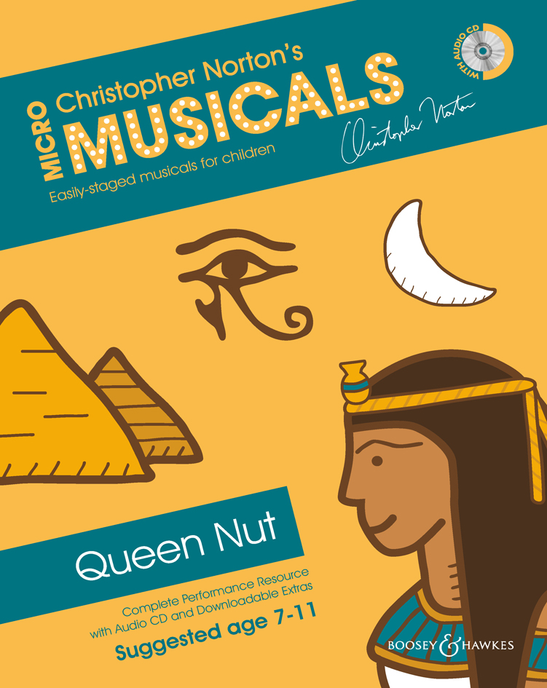
QUEEN NUT
Songs

Slide 2
SONG 1
THE EGYPTIANS
© Copyright 2014 by Boosey & Hawkes Music Publishers Ltd

Slide 3
Pyramids.
Astronomy.
Hieroglyphics.
Boat construction.
Dam construction.
Make-up.
Jewellery.
Egyptians made all of these.
(And don’t forget mummification!)

Slide 5
SONG 2
RA – THE SUN GOD
© Copyright 2014 by Boosey & Hawkes Music Publishers Ltd

Slide 6
Ra – the sun god, ruler alone,
feared that someone
would take his throne.
A year of three hundred and sixty days.
Ra gives an order, but Nut disobeys.
Nut was in trouble, Nut was in strife:
she wanted children, but wasn’t Ra’s wife!

Slide 7
Ra – the sun god, ruler alone,
feared that someone
would take his throne.
Nut disobeyed him; she heard him declare,
‘you shan’t give birth any day of the year.’
Nut was in trouble, Nut was in strife:
she wanted children, but wasn’t Ra’s wife!

Slide 9
SONG 3
HAVE YOU HEARD?
© Copyright 2014 by Boosey & Hawkes Music Publishers Ltd

Slide 10
Have you heard?
Can it be true?
Queen Nut said
she will give birth
to the future Pharaoh,
to the future Pharaoh.

Slide 11
Have you heard?
Can it be true?
Queen Nut said
she will give birth
to the future Pharaoh,
to the future Pharaoh.

Slide 13
SONG 4
I CURSE YOU!
© Copyright 2014 by Boosey & Hawkes Music Publishers Ltd

Slide 14
RA:
I curse you!
I curse the child you say you bear!
I hate you!
I hate the way you will not hear
that I’m the sun god,
I’m your ruler!’

Slide 15
I curse you!
I curse the child you say you bear!
I hate you!
I hate the way you will not hear
that I’m the sun god,
I’m your ruler!’

Slide 16
ALL:
Nut shall not give birth
any day of the year
or she’ll be cursed!

Slide 18
SONG 5
PLEASE HELP ME
© Copyright 2014 by Boosey & Hawkes Music Publishers Ltd

Slide 19
NUT:
Please help me, I need your wisdom.
Pharaoh has cursed the child within me;
my heart is broken.

Slide 20
Please help me, I need your wisdom.
Pharaoh has cursed the child within me;
my heart is broken.
Help me, help me.

Slide 21
Please help me.
My heart is broken.
Please help.
Please help me.

Slide 23
SONG 6
THE WAGER
© Copyright 2014 by Boosey & Hawkes Music Publishers Ltd

Slide 24
ALL:
Game one!
THOTH:
An hour of light for every game I win.
I win!

Slide 25
ALL:
Game two!
THOTH:
An hour of light for every game I win.
I win!

Slide 26
ALL:
Game three!
THOTH:
An hour of light for every game I win.
I win!

Slide 27
ALL:
Game four!
THOTH:
An hour of light for every game I win.
I win!

Slide 28
ALL:
Game five!
THOTH:
An hour of light for every game I win.
I win!

Slide 29
KHONSHU:
You’re a coward and a cheat,
so take your light and leave!

Slide 31
SONG 7
FIVE EXTRA DAYS
© Copyright 2014 by Boosey & Hawkes Music Publishers Ltd

Slide 32
THOTH:
Five extra days in the calendar,
five extra days in the year.
Five extra days in the calendar,
now five children can be born.

Slide 33
ALL:
Five extra days in the calendar,
five extra days in the year.
Five extra days in the calendar,
now five children can be born.

Slide 34
The goddess gives birth to five children
on the five days, thus avoiding the curse.

Slide 36
SONG 8
NAMES
© Copyright 2014 by Boosey & Hawkes Music Publishers Ltd

Slide 37
Osiris,
Horus the Elder,
Isis, Set and Nepthys.
These are the names
of the children of Queen Nut
and her husband.

Slide 38
Ra is angry.
The moon loses strength.
Ra is angry.
The moon loses strength.

Slide 40
SONG 9
THE EGYPTIANS
(Reprise)
© Copyright 2014 by Boosey & Hawkes Music Publishers Ltd

Slide 41
Pyramids.
Astronomy.
Hieroglyphics.
Boat construction.
Dam construction.
Make-up.
Jewellery.
Egyptians made all of these.
(And don’t forget mummification!)

