Slide 1
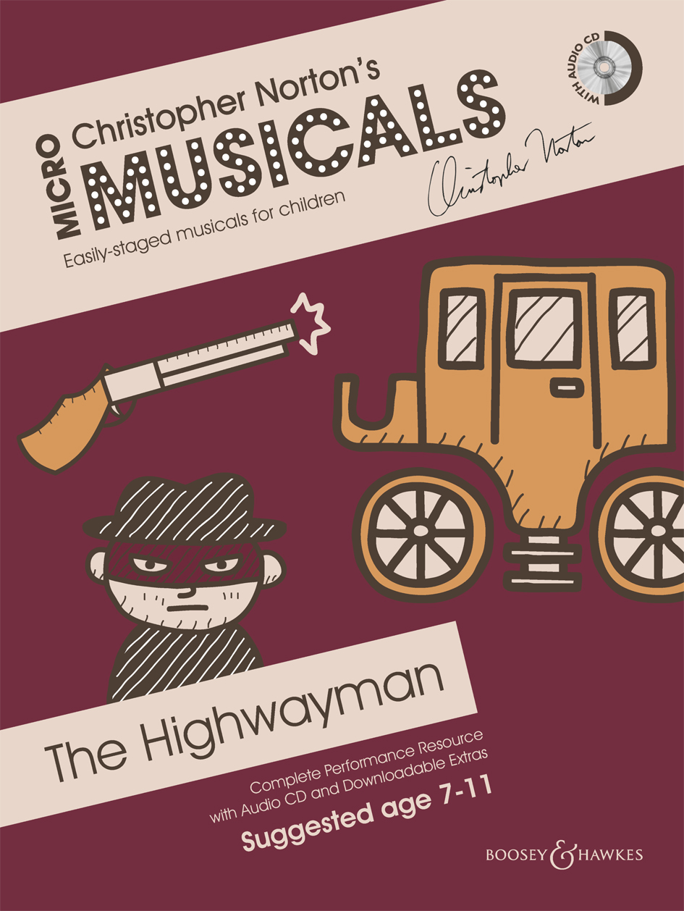
THE HIGHWAYMAN Songs

Slide 2
SONG 1 HOWLING, MOANING
© Copyright 2014 by Boosey & Hawkes Music Publishers Ltd

Slide 3
Howling, moaning,
the wind whistled through the trees,
and the highwayman came riding
with the moon like a ship on the seas.

Slide 5
SONG 2 BESS
© Copyright 2014 by Boosey & Hawkes Music Publishers Ltd

Slide 6
ALL: With his French cocked-hat
and his swagg’ring air
and a flash at his chin
of fine lace so fair,
his claret coat and his fancy tie
made him twinkle
under the jewelled sky.

Slide 7
THE HIGHWAYMAN:
‘I’ll return to the old inn-yard,
though its shutters there
will be locked and barred.
Bess will wait ‘neath a ghostly moon
for the sound of my horse
and my whistled tune.

Slide 8
ALL: With her piercing eyes
and her long black hair,
the landlord’s daughter
was waiting there.
She plaited a love-knot
so dark and red
as she murmured the words
to her love she’d said:

Slide 9
BESS:
‘Come back soon;
I’ll be waiting here
for your tap on the window,
your tuneful air.
I will open the gate for you.
You’ll be welcomed here
by my love so true.’

Slide 11
SONG 3 ONE KISS, MY BONNY SWEETHEART
© Copyright 2014 by Boosey & Hawkes Music Publishers Ltd

Slide 12
‘One kiss my bonny sweetheart,
I’m after a prize tonight,
but I shall be back with the yellow gold
before the morning light.
Yet if they press me sharply
and harry me through the day
then look for me by moonlight
though Hell should bar the way.’

Slide 13
Upright in the stirrups
he scarce could reach her hand
but she loosed her hair in the casement;
his face burnt like a brand.
As the sweet black waves of perfume
came tumbling o’er his breast
then he kissed its waves in the moonlight
then galloped away to the west.

Slide 15
NARRATOR 2:
He rose upright in the stirrups;
he scarce could reach her hand,
But she loosened her hair i’ the casement!
His face burnt like a brand.
As the black cascade of perfume
came tumbling over his breast;
And he kissed its waves in the moonlight,
(Oh, sweet, black waves in the moonlight!)
Then he tugged at his rein in the moonlight,
and galloped away to the West.

Slide 17
SONG 4 LOOK FOR ME IN THE MOONLIGHT
© Copyright 2014 by Boosey & Hawkes Music Publishers Ltd

Slide 18
The highwayman galloped
away to the night.
He did not return with the morning light.
Bess waited so long, she waited in vain,
but over and over she heard his refrain:

Slide 19
‘Look for me in the moonlight,
watch for me in the moonlight,
I’ll come to you in the moonlight,
though hell should bar the way.’

Slide 21
SONG 5 REDCOATS
© Copyright 2014 by Boosey & Hawkes Music Publishers Ltd

Slide 22
Redcoats came marching
up to the inn-keeper’s door;
they drank his ale then bound poor Bess
and left her there, trapped for sure.

Slide 23
Two of them knelt at the window
with muskets by their side
waiting for the highwayman
on the road where they knew he would ride.

Slide 24
‘Look for me in the moonlight,’
he’d said as he rode once more.
Beth knew for sure death lay in wait
if he returned to that door.

Slide 25
Redcoats came marching.
Redcoats came marching.

Slide 27
SONG 6 BESS WAS BOUND
© Copyright 2014 by Boosey & Hawkes Music Publishers Ltd

Slide 28
Bess was bound.
See them jest.
Tied a rifle beside her,
pointing at her breast.
They kissed her in the darkness
and she heard her dead love say:

Slide 29
‘Look for me by moonlight,
watch for me by moonlight,
I’ll come to you by moonlight,
though Hell should bar the way.’

Slide 30
Bess was trapped.
The knots held good.
She writhed her hands
until wet with blood.
She stretched and strained in darkness
till the trigger at last was hers.

Slide 31
‘Look for me by moonlight,
watch for me by moonlight,
I’ll come to you by moonlight,
though Hell should bar the way.’

Slide 33
SONG 7 THE HIGHWAYMAN APPROACHES (part 1)
© Copyright 2014 by Boosey & Hawkes Music Publishers Ltd

Slide 34
They heard the sound of horse’s hooves;
the highwayman appeared.
She stood up at attention,
the barrel beneath her breast.
Her finger moved in the moonlight;
she warned him with her death.

Slide 36
SONG 8 THE HIGHWAYMAN APPROACHES (part 2)
© Copyright 2014 by Boosey & Hawkes Music Publishers Ltd

Slide 37
Then back he spurred,
went back to the inn,
his rapier brandished high.
They shot him down on the highway.
He lay in his blood on the highway
with the bunch of lace at his throat.

Slide 39
SONG 9 AND STILL OF A WINTER’S NIGHT
© Copyright 2014 by Boosey & Hawkes Music Publishers Ltd

Slide 40
And still of a winter’s night, they say,
when the wind is in the trees,
when the moon is a ghostly galleon
tossed upon cloudy seas,
when the road is a ribbon of moonlight
over the purple moor,
a highwayman comes riding
up to the old inn-door.

Slide 41
Over the cobbles he clatters still
and he sees the dark inn-yard;
and he taps with his whip on the shutters,
but all is locked and barred;
Still he whistles a tune to the window;
who should be waiting there
but the landlord’s black-eyed daughter,
love-knot in her hair.

Slide 42
‘Look for me in the moonlight,
watch for me in the moonlight,
I’ll come to you in the moonlight,
though hell should bar the way.

Slide 43
‘Look for me in the moonlight,
watch for me in the moonlight,
I’ll come to you in the moonlight,
though hell should bar the way.

