Slide 1
THE LITTLE MERMAID Script & Songs

Slide 2
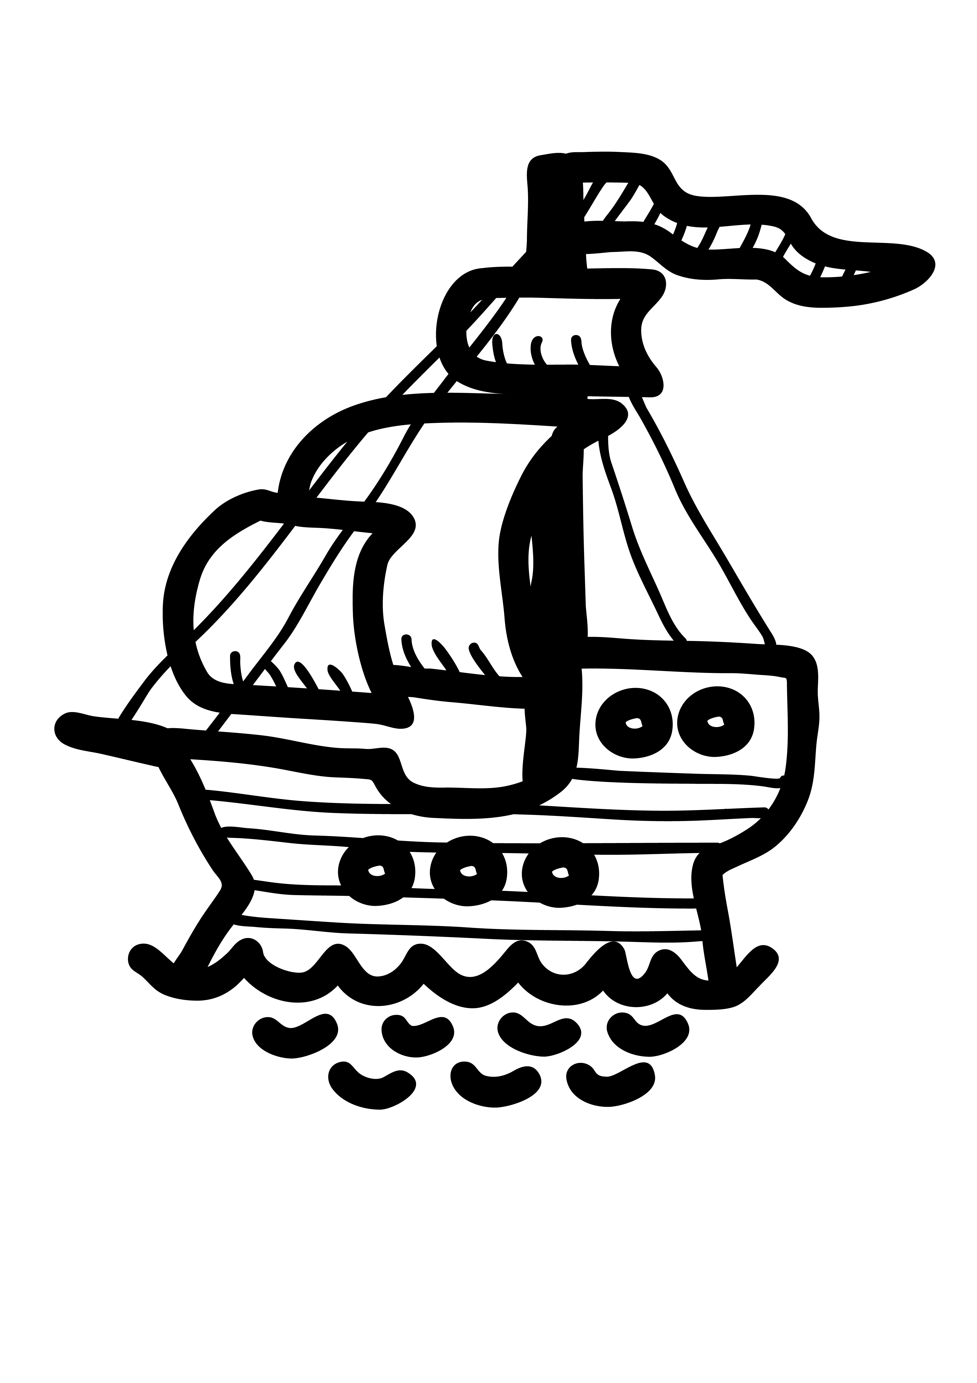
SONG 1 WELCOME TO THE OCEAN WORLD
© Copyright 2014 by Boosey & Hawkes Music Publishers Ltd

Slide 3
Welcome to the ocean world.
It’s a world of delight,
a wonderful sight! You can see all the fish and mammals;
you’ll wish that you could go there.

Slide 4
Welcome to the ocean world.
There are blue whales and sharks
and undersea parks.
You can swim by a reef,
get right underneath
the surface of things.

Slide 5
No-one is sure what is down there.
Mermaids and kings of the sea?
Cities are lost in the waters.
Where can they be?

Slide 7
NARRATOR 1:
Welcome to our ocean!
Oceans are large bodies of water
and they are very deep.
This is the deepest,
and all the way down
at the very, very bottom is our kingdom.
A kingdom ruled over by the Sea King.

Slide 8
NARRATOR 2:
In our kingdom there are mermaid families.

Slide 9
NARRATOR 1:
A mermaid is a creature
who is half human, half fish –
with a tail instead of legs.

Slide 10
NARRATOR 2:
In one mermaid family
there were six daughters.

Slide 11
NARRATOR 1:
The youngest daughter,
and the littlest of the mermaids,
was called Marina.
She was known for her beautiful,
sweet singing voice.

Slide 13
SONG 2 AT THE BOTTOM OF THE SEA
© Copyright 2014 by Boosey & Hawkes Music Publishers Ltd

Slide 14
At the bottom of the sea
the Sea King rules.
There are plants, there are fish,
there are mermaid schools.
Six little mermaids live down there,
and the youngest one has a face so fair.

Slide 15
She has a tail but she has no feet,
and she sings like an angel;
her voice so sweet.
Skin so soft it would make you cry.
Eyes as blue as a summer sky.

Slide 16
She would love to visit the world above
where she dreams of finding
someone to love.
Her desire is a human soul,
so the ocean surface is her goal.

Slide 18
NARRATOR 2:
If they are kind and do good deeds,
mermaids become Spirits of the Air,
which means they can live as long
as three hundred years!

Slide 19
NARRATOR 1:
Marina had not yet become
a Spirit of the Air.
She was impatient and wanted to go
to the world above the ocean right away!

Slide 20
GRANDMOTHER:
Marina!
Hurry, please – you mustn’t keep
your sisters and I waiting!

Slide 21
MARINA:
Grandmother, when can I go
to the ocean surface?
I want to visit the world above!
I’m tired of living here.

Slide 22
GRANDMOTHER:
You will make your trip to the surface
and see the world of humans,
but not until you’re fifteen years old.

Slide 23
MARINA:
But I want to know what’s up there now!
Why do I have to wait? Why?

Slide 24
GRANDMOTHER:
That is the rule of the Sea King.
Now, not another word Marina,
you must come home straight away!

Slide 26
SONG 3 I WISH THAT I COULD TRAVEL
© Copyright 2014 by Boosey & Hawkes Music Publishers Ltd

Slide 27
MARINA:
I wish that I could travel
and see the world up there.
I hear that stars shine brightly
and music fills the air.

Slide 28
I’d like to go much sooner,
not wait till I’m fifteen.
It all sounds so exciting,
these things I’ve never seen.
I want to go there
and see things for myself.

Slide 30
I’m sure I’ll find a prince there
who’ll want to marry me.
He’ll want to meet a mermaid
who lives beneath the sea.

Slide 31
The waiting’s nearly over
and then the sun will shine
on me and my beloved.
The world will soon be mine.
I want to go there
and see things for myself.

Slide 33
SISTERS:
She dreams of going up there.
She really cannot wait
to see the world above her
before it is too late.

Slide 34
She wishes she could travel
and see the world up there.
She’s heard that stars shine brightly
and music fills the air.

Slide 35
She’d like to go much sooner,
not wait till she’s fifteen.
It all sounds so exciting,
these things she’s never seen.

Slide 36
MARINA:
I want to go there
and see things for myself.
I want to go there
and see things for myself.

Slide 38
NARRATOR 2:
Before the mermaids could swim
to the ocean’s surface,
they had to have the official consent
of the Sea King

Slide 39
NARRATOR 1:
And having waited...

Slide 40
NARRATOR 2:
…and waited...

Slide 41
NARRATOR 1:
…and waited even more...

Slide 42
NARRATOR 2:
…at last Marina,
the Little Mermaid, was fifteen!

Slide 43
GRANDMOTHER:
Goodbye my sweet Little Mermaid.
Please be careful.

Slide 44
NARRATOR 1:
Up, up she went.
She swam right up to the surface –
as light and sparkling
as a beam of sunshine.

Slide 45
NARRATOR 1:
The sea was calm,
and as she looked across the water,
straight ahead of her Marina saw a ship.
For the first time in her life
she could hear music and singing,
and as the sun set
and the sky started twinkling with stars,
sailors on board lit hundreds
of brightly coloured lanterns.

Slide 46
NARRATOR 2:
The Little Mermaid swam right up
to the window of the main cabin
and looked inside.
There were lots of people there,
eating and drinking and dancing to the music,
but right away she noticed a handsome boy.

Slide 47
NARRATOR 1:
All of a sudden, a terrible storm
blew up and the ship was in danger.
The winds grew stronger,
the rain fell heavier,
and the waves stretched taller and taller.
Marina was horrified as she watched
the young man swept overboard.

Slide 48
MARINA:
Surely, he will drown!

Slide 49
NARRATOR 2:
She swam through the waves
until she reached the young man,
and she carried him to a nearby beach
and laid him on the sand.
He was very ill and had fallen fast asleep.

Slide 51
SONG 4 I HAVE YOU IN MY ARMS
© Copyright 2014 by Boosey & Hawkes Music Publishers Ltd

Slide 52
MARINA:
I have you in my arms
but you don’t know me –
a mermaid with no legs and a tail.
But if you wake, it just won’t work –
you’re human.
My search for love
is one that’s doomed to fail.

Slide 53
It’s daybreak
and land is here before us,
we’ve reached a place of safety,
but I must go.
I’ll leave you on the sand,
beside the ocean.
How you were rescued
you will never know.

Slide 55
My heart is torn,
I think that he could love me,
but now I realise it’s a dream.
How could a human
learn to love a mermaid?
My quest is not as easy as it seems.

Slide 56
It’s daybreak
and land is here before us,
we’ve reached a place of safety,
but I must leave
and find some way
that we can be together.
It has to happen.
I must just believe.

Slide 58
NARRATOR 1:
A young girl,
a princess from a neighbouring kingdom,
was walking along the seashore
when she noticed the young man
lying on the sand.
Marina had left him lying there
and was watching from behind some rocks.

Slide 59
PRINCESS:
My goodness, it’s Prince Stefan!
Prince Stefan! Wake up!
What is he doing here?
He must have been on the ship
that was wrecked last night.
I must go for help.

Slide 60
MARINA:
Oh dear! He is waking up
and that girl said he is a Prince!
But he won’t know who has rescued him.
He’ll think it was her!
How will he ever know it was me?

Slide 61
NARRATOR 1:
Marina dived sadly into the water
and returned to her home
at the bottom of the sea.
She was right –
the Prince didn’t know who had rescued him –
he did think it was the Princess
who had found him on the beach.

Slide 62
NARRATOR 2:
The Little Mermaid now wanted even more
to become human
so that she could see the Prince again.
Desperate for help,
she went to a Sea Witch for advice.

Slide 63
MARINA:
Please, I have come to ask for advice.
I want to go and live on the surface.
I want to be a human.
Can you help me?

Slide 64
SEA WITCH:
I can help you, Marina.
I have a potion that will give you legs
like a human.
But if you take it,
you will never be able to talk or sing again.

Slide 65
SEA WITCH:
If you do you will be in constant pain
when you walk.
And if the Prince marries someone else,
you must leave the land,
but you will not be able to return
to your sea home either.
You will disappear.

Slide 66
SEA WITCH:
I think you should forget your dream
of marrying a human.
Think about what good and kind things
you can do to become a Spirit of the Air.

Slide 67
SERVANTS:
Yes! Become a Spirit of the Air,
beautiful Marina!

Slide 68
MARINA:
Please – I must see the Prince again.
Give me the potion.
I want to do this

Slide 70
SONG 5 THIS POTION WILL GIVE YOU LEGS
© Copyright 2014 by Boosey & Hawkes Music Publishers Ltd

Slide 71
SEA WITCH:
This potion will give you legs,
but nevermore will you sing or talk;
and every step you take
will cause you pain when you walk.
Are you willing to do this?

Slide 72
If he marries someone new,
if you’re unable to see this through,
you will disappear,
you’ll be neither on land or on sea.
Are you able to do this?

Slide 74
NARRATOR 1:
The Little Mermaid eagerly took the potion
and then fell into a faint.
The Sea Witch took pity on her
and magically sent her back to the surface.

Slide 75
NARRATOR 2:
When Marina awoke,
she found herself lying on the ground
near the Prince’s palace.
The Prince, out on his daily walk,
found her and brought her back to the Palace.
He thought she was very beautiful.

Slide 76
NARRATOR 1:
The Prince liked Marina very much
and allowed her to stay at the palace,
but he was surprised by the fact
that she couldn’t speak.
He grew very fond of her,
and perhaps even loved her,
but was still so grateful to the Princess
who he thought had saved him
from drowning.

Slide 77
NARRATOR 1:
He loved her, and eventually
the Prince asked her to marry him.
The Princess, that is.

Slide 78
NARRATOR 2:
On the morning of the
Prince’s wedding to the Princess,
the mermaid’s sisters appeared from the sea.
They had a knife given to them
by the Sea Witch.

Slide 79
SISTER 1:
The Prince is not going to marry you.
SISTER 2:
You’re not really a human...
SISTER 3:
...but neither are you a mermaid.

Slide 80
SISTER 4:
The Sea Witch said you could never
come back to the kingdom of the sea.
SISTER 5:
But there is a way...

Slide 81
SISTER 1:
The only way you can reverse what’s
happened is to bathe your feet in the
blood of a human that you love. If you
do this, you’ll get your voice back and
will be a mermaid again and be
allowed to return to the sea.

Slide 82
SISTER 2:
You must kill the Prince.
NARRATOR 1:
The Little Mermaid was horrified.

Slide 83
SISTER 3:
You must give up this idea of being a human
and gaining a soul and think about what good
deeds you can do that will turn you into a Spirit
of the Air...
SISTER 4:
…just like us.
SISTER 5:
It’s up to you, Marina.

Slide 85
SONG 6 I CAN’T DO THIS
© Copyright 2014 by Boosey & Hawkes Music Publishers Ltd

Slide 86
MARINA:
I can’t do this; I love him too much,
so I’ll throw away the knife
and set him free.
I can’t stay here once he marries
but neither can I go back to the sea.
This was never meant to be.

Slide 87
PRINCE:
I’m so happy, I’m being married
to the girl who saved my life
down by the sea.
But I wonder where the girl is
who never spoke a single word to me;
it remains a mystery.

Slide 89
NARRATOR 2:
The Little Mermaid did something completely
selfless – she put the Prince’s happiness
above her desire to live forever.
But sadly the Sea Witch’s warning became true:
as the Prince and Princess got married,
the Little Mermaid disappeared.

Slide 90
NARRATOR 1:
She could no longer live on the land,
but she couldn’t return to the sea either.

Slide 91
NARRATOR 2:
Perhaps she should have taken the Sea Witch’s
advice not to take the potion in the first place?

Slide 93
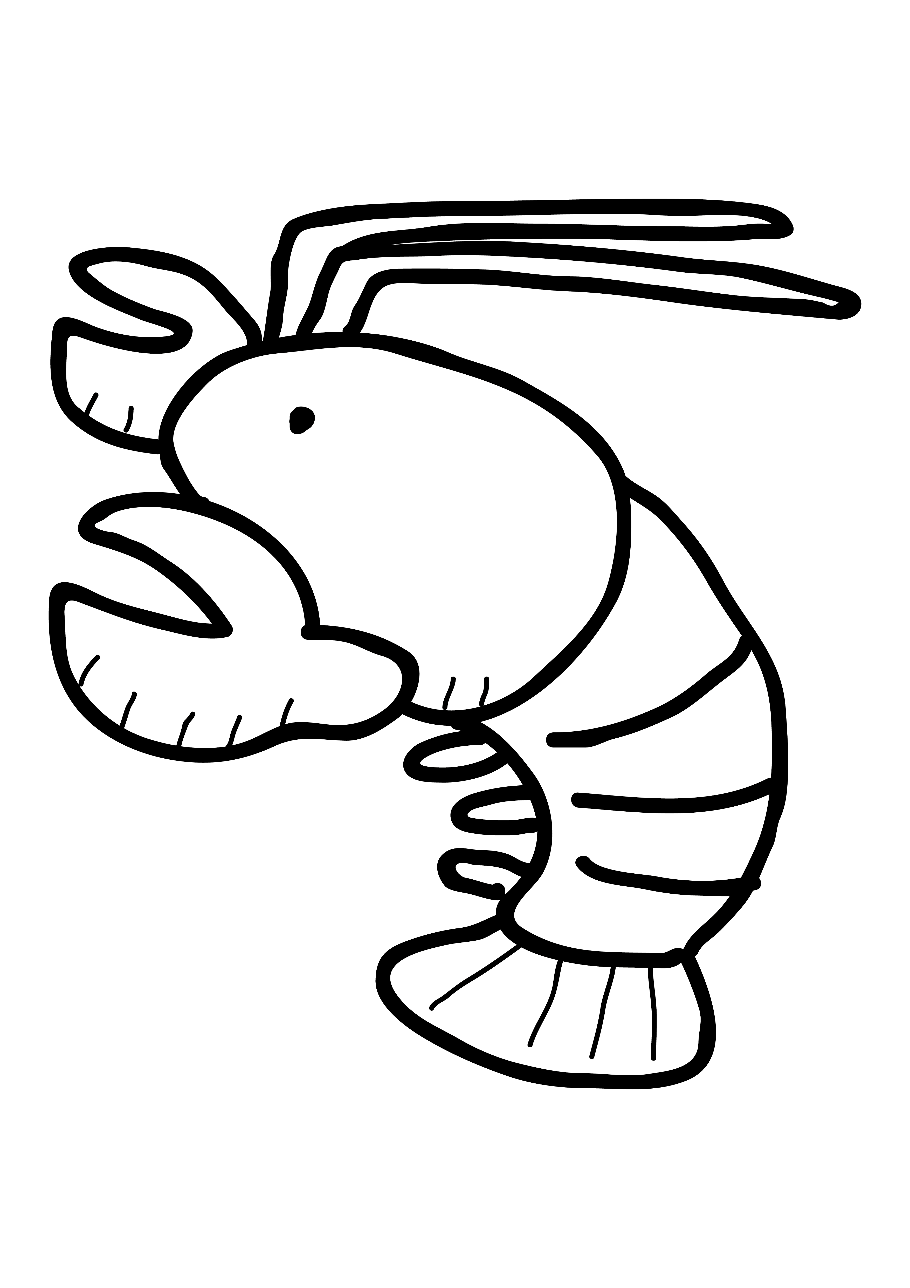
SONG 7 DOWN, DOWN AT THE BOTTOM OF THE SEA
© Copyright 2014 by Boosey & Hawkes Music Publishers Ltd

Slide 94
Blow out your bubbles,
waggle your tail.
Don’t make any trouble,
you just gotta sail!
‘Cause this is a day
that’s groovy and cool;
all the little Sea kids
goin’ back to school!

Slide 95
Hey, Katie Blowfish,
go, get in line!
And you, Stella Starfish,
you’re lookin’ just fine!
Ebenezer Sea Slug,
don’t be a fool!
Time for all us sea kids
to go back to school!

Slide 96
Oliver Oyster,
finish your tea.
Tell us who our teacher
is going to be.
We will all work hard
for someone we like,
‘cause it’s time for school
for marlin, bream and pike.

Slide 97
Down, down, down
at the bottom of the sea,
way down here,
you just have to agree:
we have more action,
we have more fun
than all those land lovers
under the sun!

Slide 99
OLIVER OYSTER:
Ahem, ahem, it gives me great pleasure
to announce the name of our new teacher
here at the school of fish.
The name of our new teacher is...
…MARINA, THE LITTLE MERMAID!

Slide 101
MARINA:
I thought I’d never see you
or my home ‘neath the sea.
The land above was never
a place where I could be.
The Sea King let me come back,
gave me a chance to live
but I must do the right things
and I must learn to give.

Slide 102
‘Cause I’m a mermaid
who lives beneath the sea.
A Spirit of the Air
is all I want to be.

Slide 104
Down, down, down
at the bottom of the sea,
way down here,
you just have to agree:
we have more action,
we have more fun
than all those land lovers
under the sun!

Slide 105
Down, down, down
at the bottom of the sea,
way down here,
you just have to agree:
we have more action,
we have more fun
than all those land lovers
under the sun!

