Slide 1
THE LITTLE MERMAID Songs

Slide 2
SONG 1 WELCOME TO THE OCEAN WORLD
© Copyright 2014 by Boosey & Hawkes Music Publishers Ltd

Slide 3
Welcome to the ocean world.
It’s a world of delight,
a wonderful sight! You can see all the fish and mammals;
you’ll wish that you could go there.

Slide 4
Welcome to the ocean world.
There are blue whales and sharks
and undersea parks.
You can swim by a reef,
get right underneath
the surface of things.

Slide 5
No-one is sure what is down there.
Mermaids and kings of the sea?
Cities are lost in the waters.
Where can they be?

Slide 7
SONG 2 AT THE BOTTOM OF THE SEA
© Copyright 2014 by Boosey & Hawkes Music Publishers Ltd

Slide 8
At the bottom of the sea
the Sea King rules.
There are plants, there are fish,
there are mermaid schools.
Six little mermaids live down there,
and the youngest one has a face so fair.

Slide 9
She has a tail but she has no feet,
and she sings like an angel;
her voice so sweet.
Skin so soft it would make you cry.
Eyes as blue as a summer sky.

Slide 10
She would love to visit the world above
where she dreams of finding
someone to love.
Her desire is a human soul,
so the ocean surface is her goal.

Slide 12
SONG 3 I WISH THAT I COULD TRAVEL
© Copyright 2014 by Boosey & Hawkes Music Publishers Ltd

Slide 13
MARINA:
I wish that I could travel
and see the world up there.
I hear that stars shine brightly
and music fills the air.

Slide 14
I’d like to go much sooner,
not wait till I’m fifteen.
It all sounds so exciting,
these things I’ve never seen.
I want to go there
and see things for myself.

Slide 16
I’m sure I’ll find a prince there
who’ll want to marry me.
He’ll want to meet a mermaid
who lives beneath the sea.

Slide 17
The waiting’s nearly over
and then the sun will shine
on me and my beloved.
The world will soon be mine.
I want to go there
and see things for myself.

Slide 19
SISTERS:
She dreams of going up there.
She really cannot wait
to see the world above her
before it is too late.

Slide 20
She wishes she could travel
and see the world up there.
She’s heard that stars shine brightly
and music fills the air.

Slide 21
She’d like to go much sooner,
not wait till she’s fifteen.
It all sounds so exciting,
these things she’s never seen.

Slide 22
MARINA:
I want to go there
and see things for myself.
I want to go there
and see things for myself.

Slide 24
SONG 4 I HAVE YOU IN MY ARMS
© Copyright 2014 by Boosey & Hawkes Music Publishers Ltd

Slide 25
MARINA:
I have you in my arms
but you don’t know me –
a mermaid with no legs and a tail.
But if you wake, it just won’t work –
you’re human.
My search for love
is one that’s doomed to fail.

Slide 26
It’s daybreak
and land is here before us,
we’ve reached a place of safety,
but I must go.
I’ll leave you on the sand,
beside the ocean.
How you were rescued
you will never know.

Slide 28
My heart is torn,
I think that he could love me,
but now I realise it’s a dream.
How could a human
learn to love a mermaid?
My quest is not as easy as it seems.

Slide 29
It’s daybreak
and land is here before us,
we’ve reached a place of safety,
but I must leave
and find some way
that we can be together.
It has to happen.
I must just believe.

Slide 31
SONG 5 THIS POTION WILL GIVE YOU LEGS
© Copyright 2014 by Boosey & Hawkes Music Publishers Ltd

Slide 32
SEA WITCH:
This potion will give you legs,
but nevermore will you sing or talk;
and every step you take
will cause you pain when you walk.
Are you willing to do this?

Slide 33
If he marries someone new,
if you’re unable to see this through,
you will disappear,
you’ll be neither on land or on sea.
Are you able to do this?

Slide 35
SONG 6 I CAN’T DO THIS
© Copyright 2014 by Boosey & Hawkes Music Publishers Ltd

Slide 36
MARINA:
I can’t do this; I love him too much,
so I’ll throw away the knife
and set him free.
I can’t stay here once he marries
but neither can I go back to the sea.
This was never meant to be.

Slide 37
PRINCE:
I’m so happy, I’m being married
to the girl who saved my life
down by the sea.
But I wonder where the girl is
who never spoke a single word to me;
it remains a mystery.

Slide 39
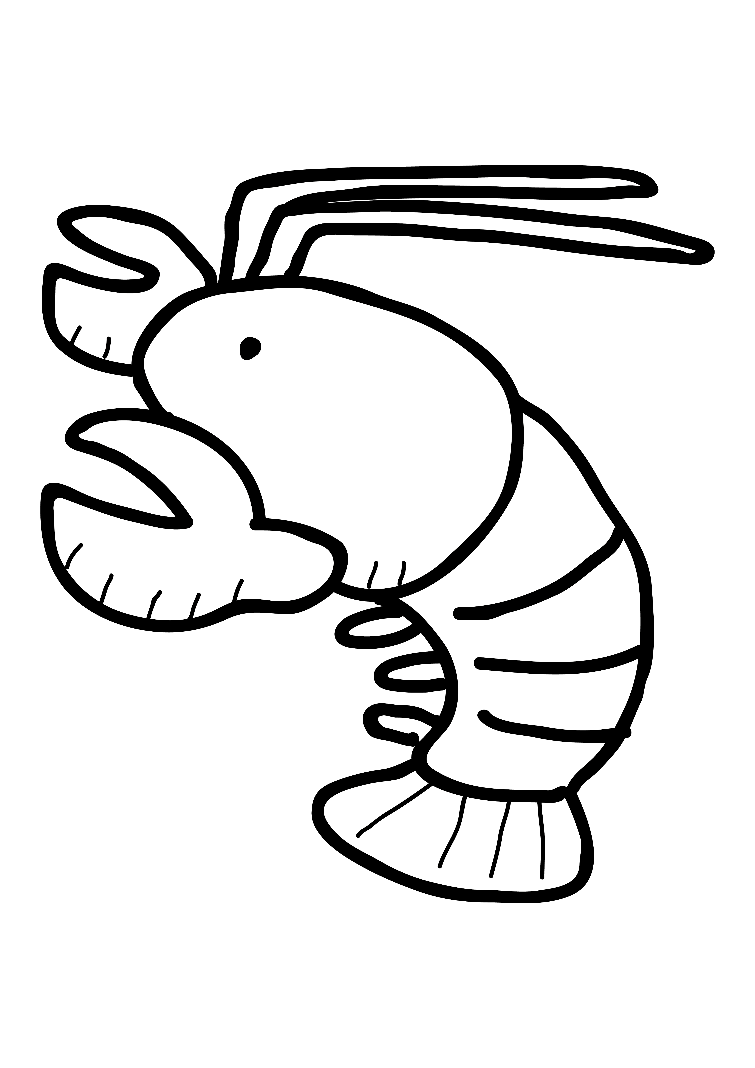
SONG 7 DOWN, DOWN AT THE BOTTOM OF THE SEA
© Copyright 2014 by Boosey & Hawkes Music Publishers Ltd

Slide 40
Blow out your bubbles,
waggle your tail.
Don’t make any trouble,
you just gotta sail!
‘Cause this is a day
that’s groovy and cool;
all the little Sea kids
goin’ back to school!

Slide 41
Hey, Katie Blowfish,
go, get in line!
And you, Stella Starfish,
you’re lookin’ just fine!
Ebenezer Sea Slug,
don’t be a fool!
Time for all us sea kids
to go back to school!

Slide 42
Oliver Oyster,
finish your tea.
Tell us who our teacher
is going to be.
We will all work hard
for someone we like,
‘cause it’s time for school
for marlin, bream and pike.

Slide 43
Down, down, down
at the bottom of the sea,
way down here,
you just have to agree:
we have more action,
we have more fun
than all those land lovers
under the sun!

Slide 45
OLIVER OYSTER:
Ahem, ahem, it gives me great pleasure
to announce the name of our new teacher
here at the school of fish.
The name of our new teacher is...
…MARINA, THE LITTLE MERMAID!

Slide 47
MARINA:
I thought I’d never see you
or my home ‘neath the sea.
The land above was never
a place where I could be.
The Sea King let me come back,
gave me a chance to live
but I must do the right things
and I must learn to give.

Slide 48
‘Cause I’m a mermaid
who lives beneath the sea.
A Spirit of the Air
is all I want to be.

Slide 50
Down, down, down
at the bottom of the sea,
way down here,
you just have to agree:
we have more action,
we have more fun
than all those land lovers
under the sun!

Slide 51
Down, down, down
at the bottom of the sea,
way down here,
you just have to agree:
we have more action,
we have more fun
than all those land lovers
under the sun!

